Slide 1
Outline of Workshop
First thing: How to use Jupyter Notebooks Morning (pre-break):
What’s all the fuss? Intro to stats, autocorrelation functions, and the consequences for inference
Basic time series: sample realizations, autocovariance matrix, periodicity, aliasing, hands-on simulation
Introduction to time series models in R and Python
Morning (post-break):
Time series analysis in R and Python: autocorrelation function estimation, time series decomposition, trend analysis, harmonic regression
Hands-on analysis of environmental time series
Afternoon:
Extension of autocorrelation to spatial dimensions
Spatial autocovariance matrices and pair-wise distance functions
Hands on fitting simple spatial models in R and Python

Slide 2
Introduction to Jupyter
“Interacting Computing Environment” allowing code, plots, texts, equations, etc. to be created and shared
Requirements:
Python 2.7 or ≥3.3 (even if working in R)
Web application (Jupyter Notebook app in browser)
Language-specific Kernel (R or Python)

Slide 3
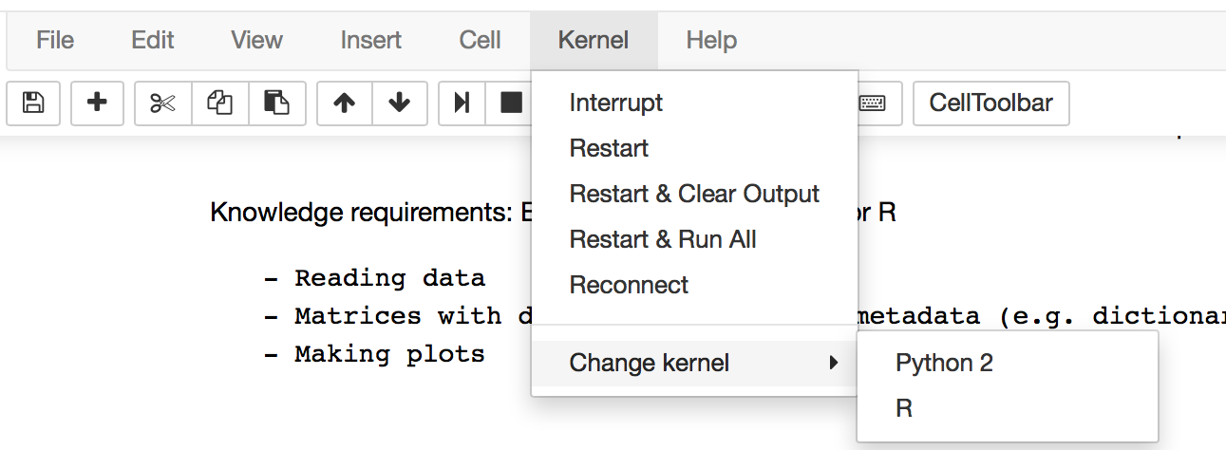
Installing Jupyter Notebooks
Download python2.7 Anaconda distribution from https://www.continuum.io/downloads and follow the on-screen instructions to install Python.
Jupyter is included with the Anaconda python installation! If working in R, you also need to install the R kernel with the following command:
conda install -c r r-essentials
Now you go to the folder containing your Jupyter notebook files in command line and launch Jupyter Notebooks:
jupyter notebook
If you want to back and forth between Kernels, You can change the kernel between Python and R under the Kernels tab:

Slide 4
Other Requirements
Python
The main packages used in the workshop (e.g. Numpy, Scipy, Matplotlib, Pandas) come pre-installed with your Conda installation. However, you also need to install statsmodels by using the conda install command in terminal:
conda install statsmodels
R

Slide 5
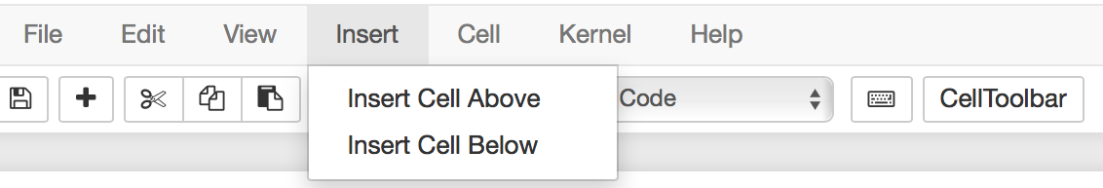
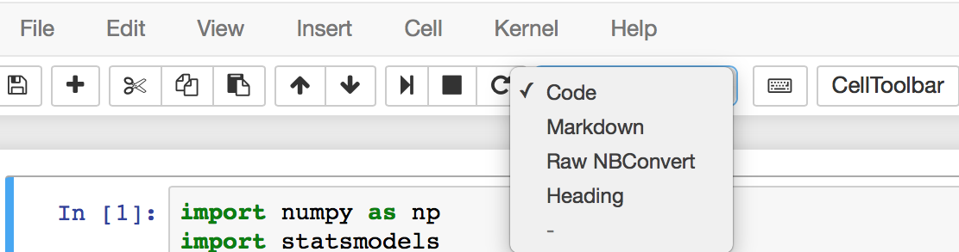
How to use Jupyter Notebooks
Everything goes inside ‘cells’. Create a cell:
Determine cell type:
Markdown for text, headers, equations;
Code for Python or R code that needs to be run (i.e. produces output).

Slide 6
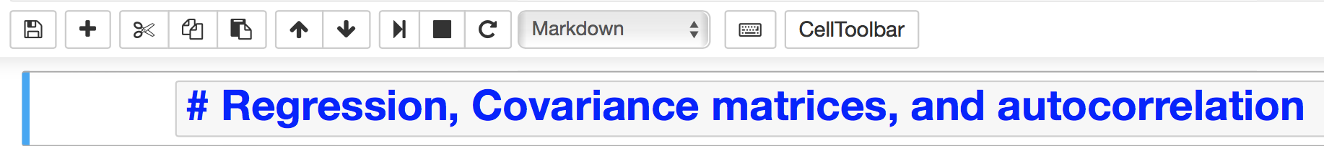
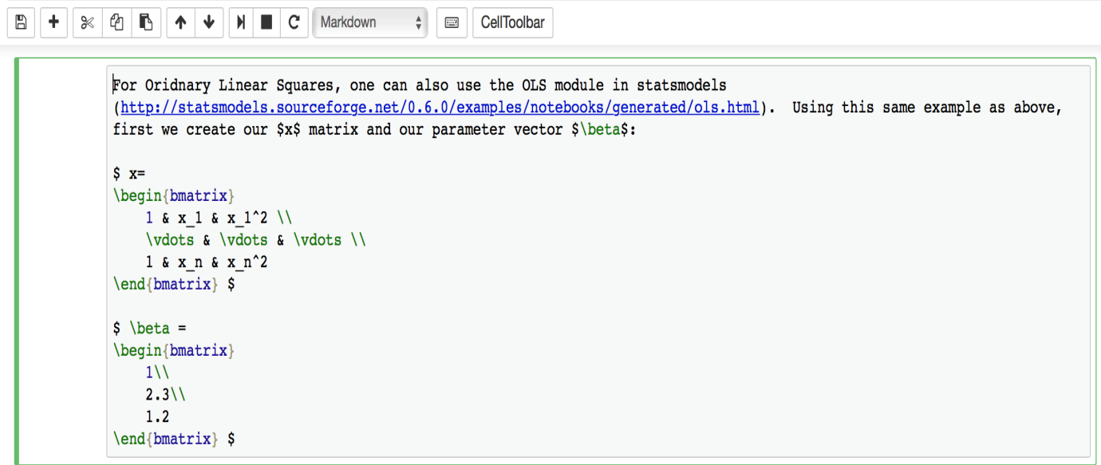
How to use Jupyter Notebooks (cont’d)
Convert Markdown to Header by simply using a # before the text and then run the cell:
Can also use Latex in Markdown:

Slide 7
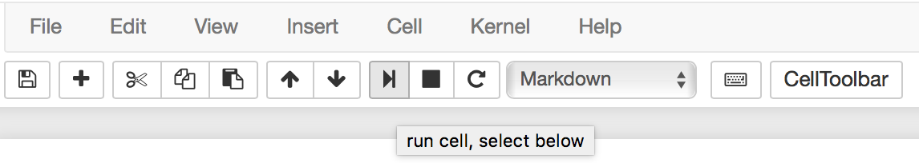
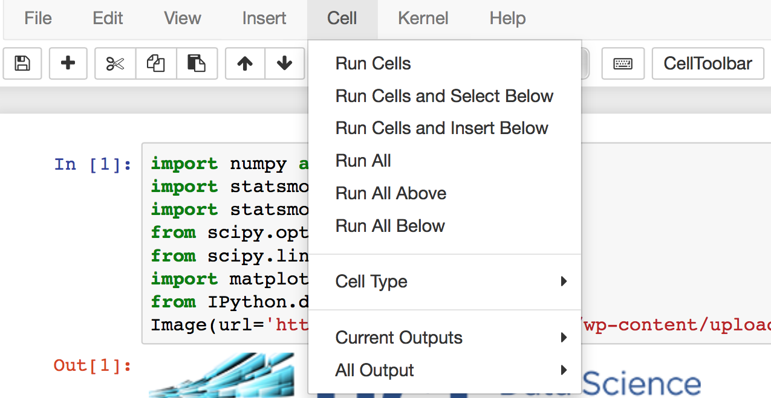
How to use Jupyter Notebooks (cont’d)
You can run each block of Mardown or code and get an output box:
Or run them all together:

Slide 8
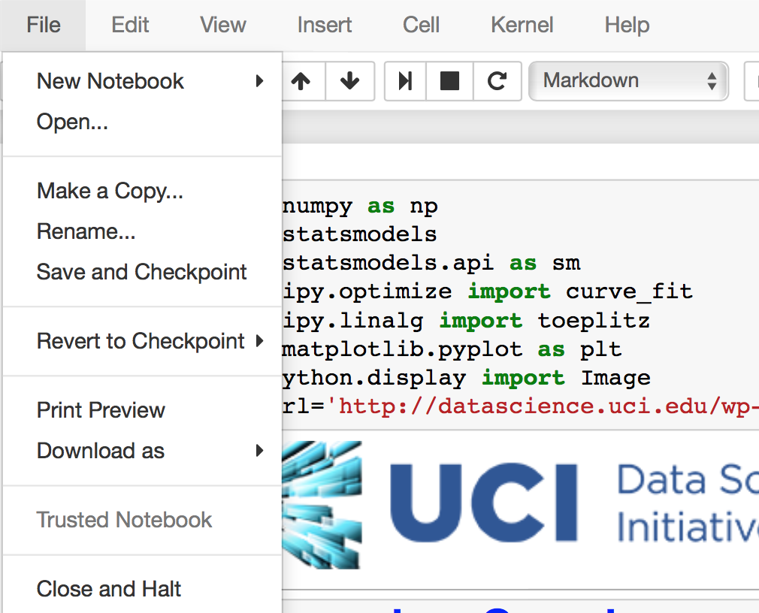
How to use Jupyter Notebooks (cont’d)
Finally, you can save a notebook when you’re done editing:
And close the kernel:

Slide 9
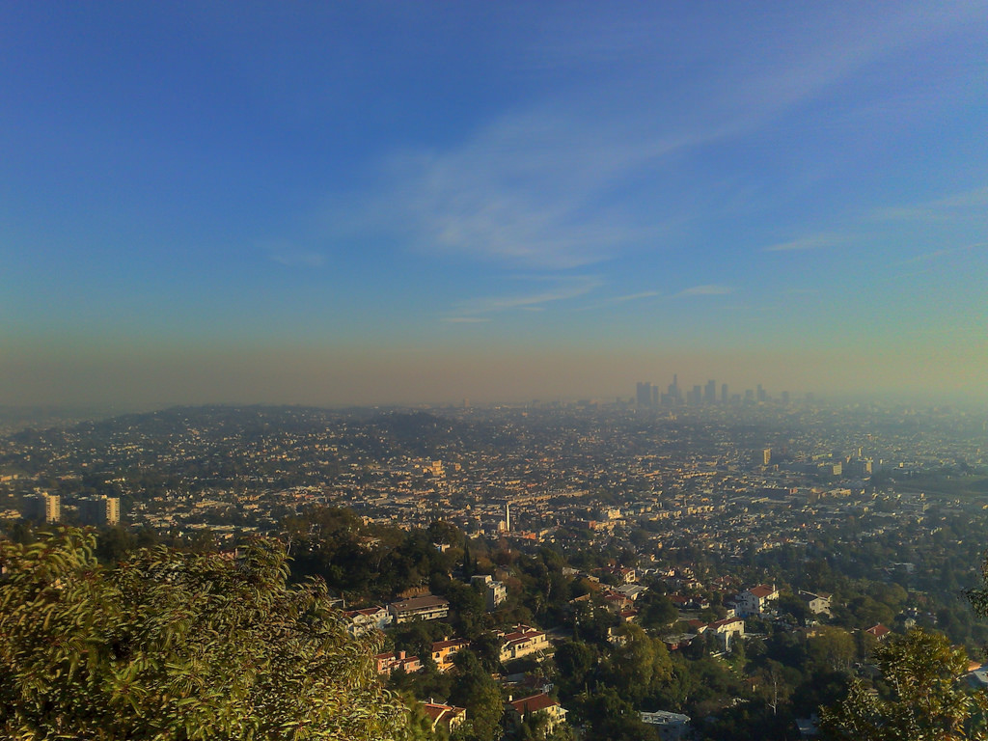







An Introduction to Environmental Statistics
UCI Data Science Initiative Short Course Gregory Britten (gbritten@uci.edu), Yara Mohajerani (ymohajer@uci.edu)

Slide 10
Is there a statistical trend in observed air quality? Are times of the year systematically worse? What environmental factors contribute to the trend?

Slide 11
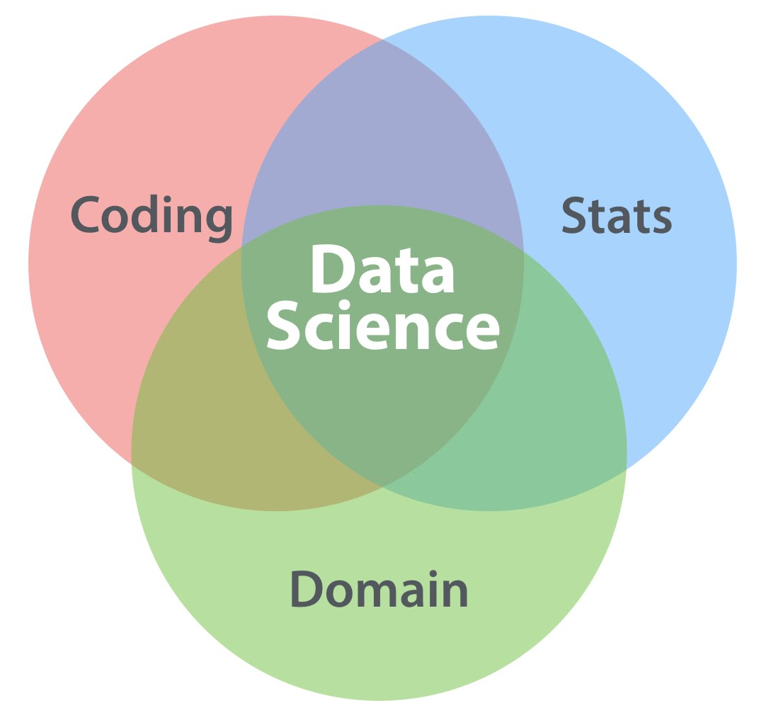
Goals of Applied Statistics
Goal of statistics is to infer properties of the data-generating process, as distinct from black box algorithms built for prediction
Today
DATALAB.CC
We will focus on statistical concepts, motivated by the science, and use standard R and Python packages, nothing fancy
Datasets are relatively small for this reason

Slide 12
Characteristics of environmental data
Autocorrelation: Measurements are collected in time and/or space, with values closer to one another more similar in magnitude than values far away
Periodicity: The earth spins and orbits the sun! Seasonal, daily, and other climate cycles are fundamental and observable in many datasets
Multicolinearity: Everything is connected to everything else, e.g. latitude, temperature
Noise: Observational, measurement error, often compounded in complex (and sometimes non-transparent) ways
Scale: Highly variable space/time scale-matching between process and observations; process scale often over or under sampled by orders of magnitude; n >> p often, but not always

Slide 13
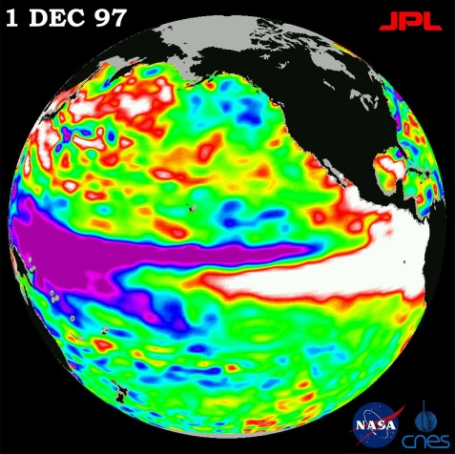
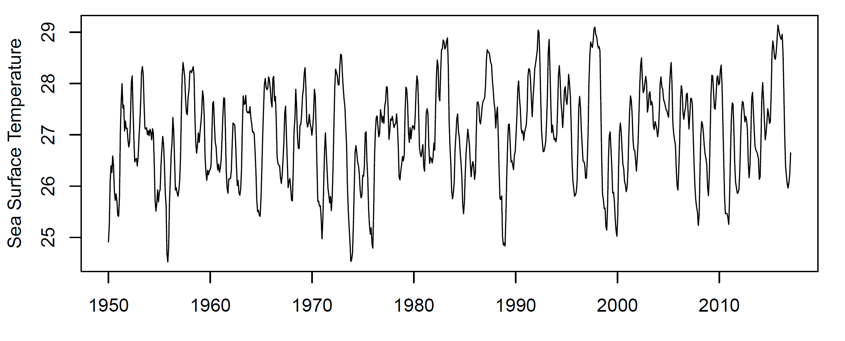
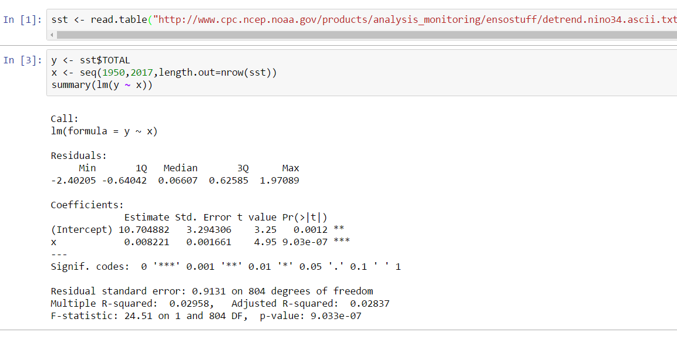
El Nino index: SST off the coast of Central America
Complex periodicities, possible trends over time
Sea Surface Temperature

Slide 14
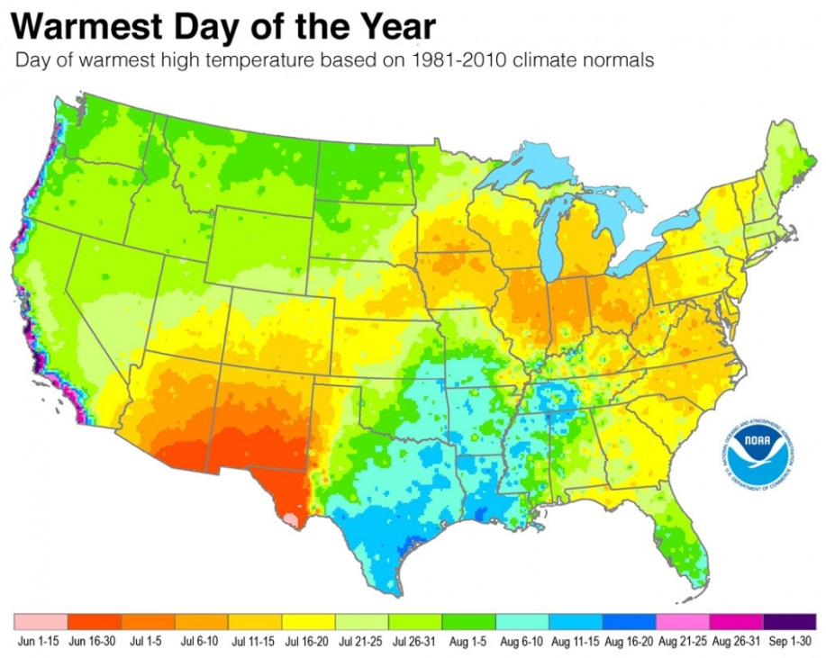
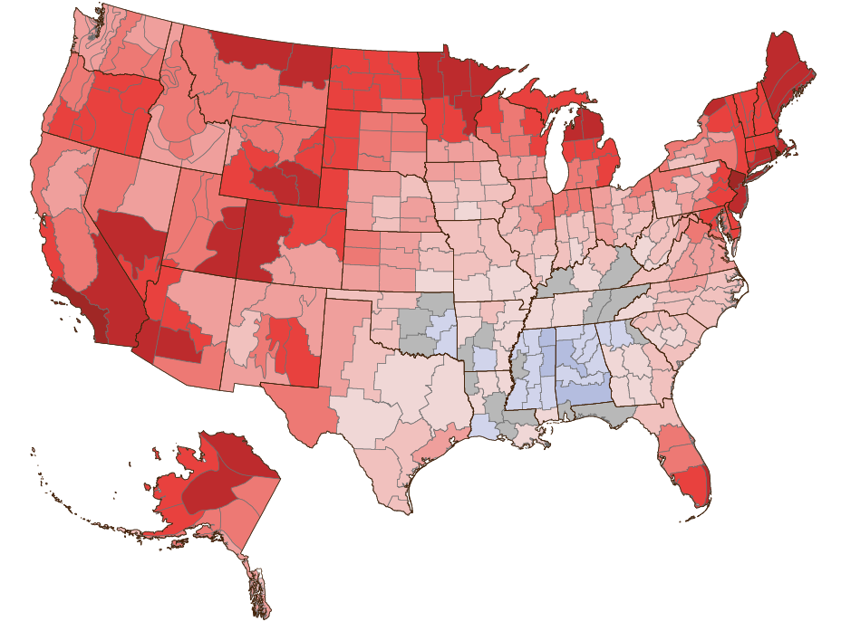
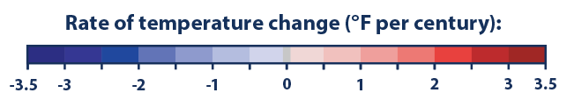
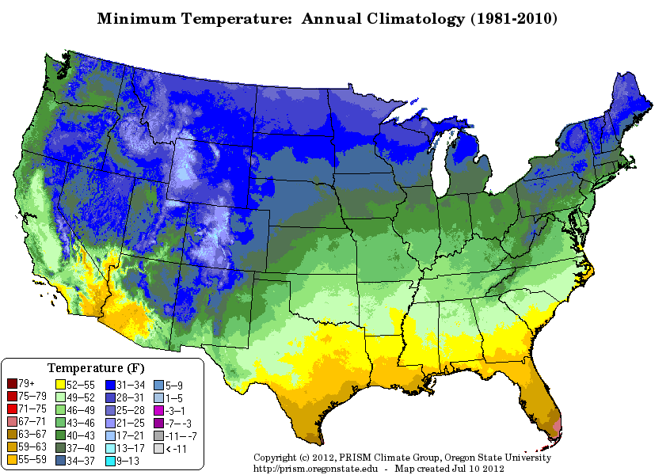
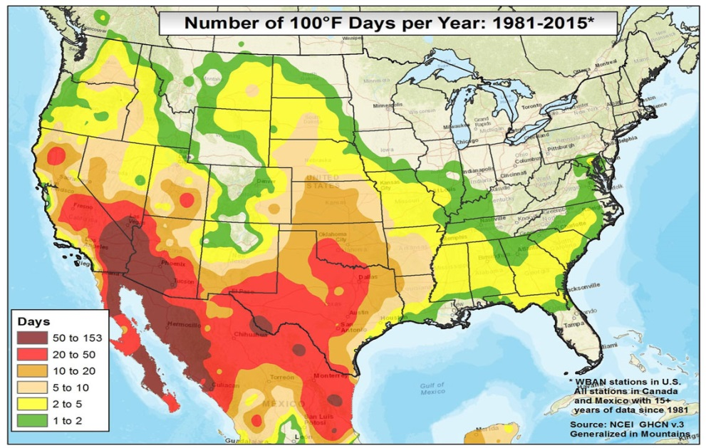

Slide 15

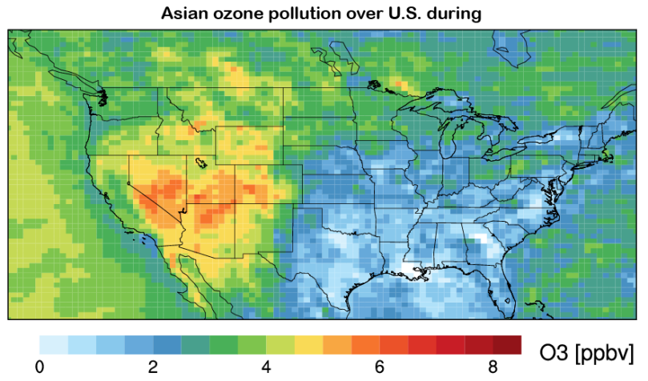
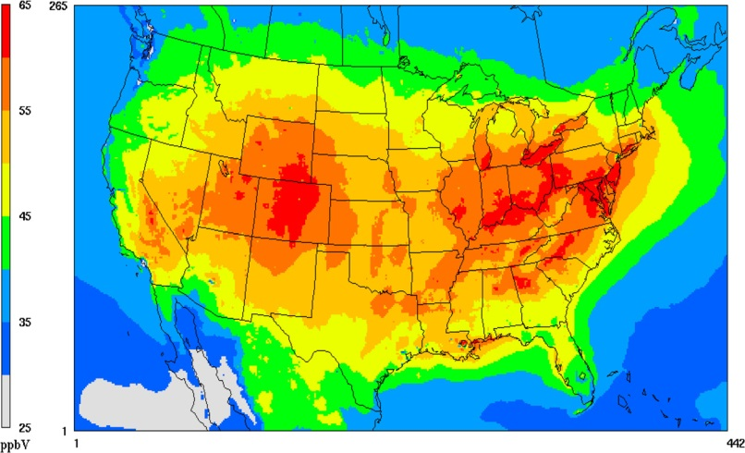
Utah department of environment claims research demonstrates Asian source of ozone, meaning the state is not in violation of EPA Empirical science hotly contested: statisticians to the rescue!
We will see how properly treating spatial/temporal properties is critical to empirical inference

Slide 16
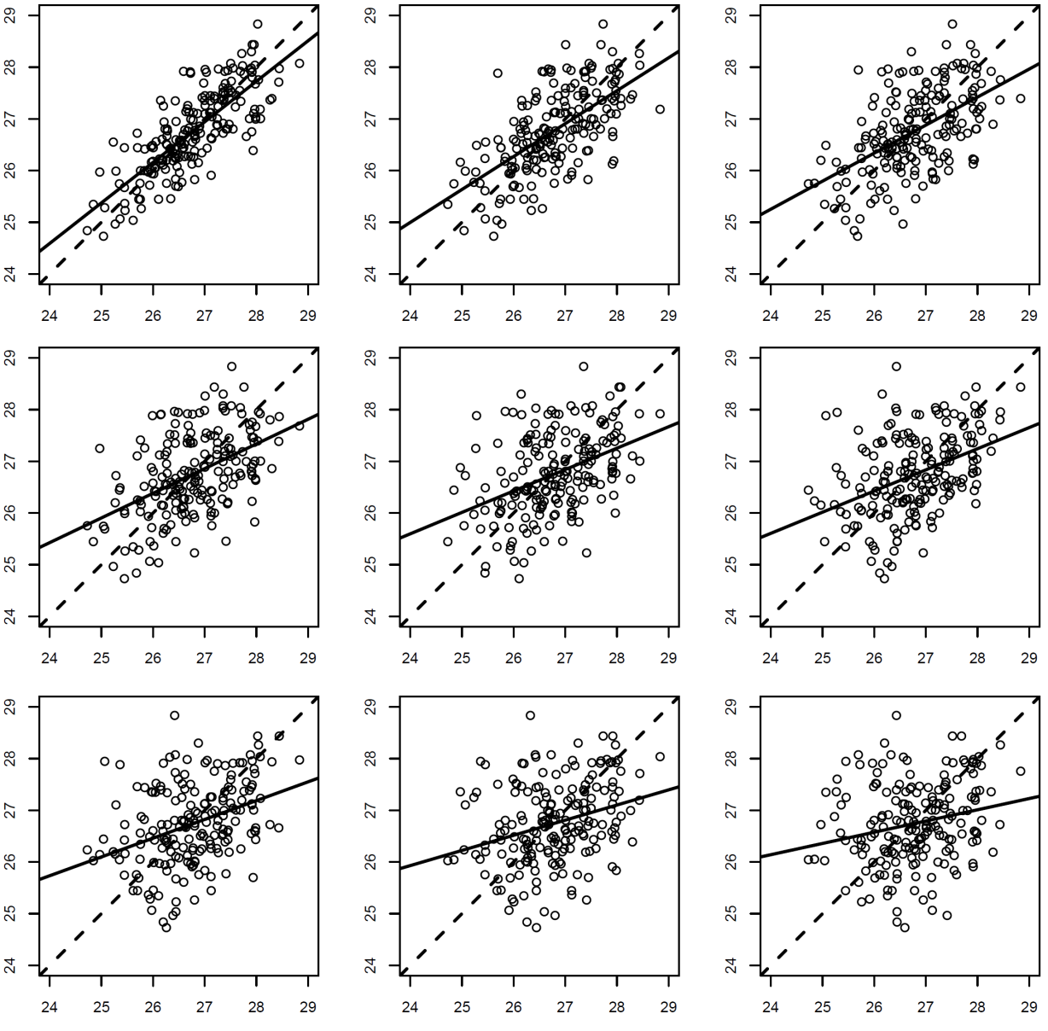
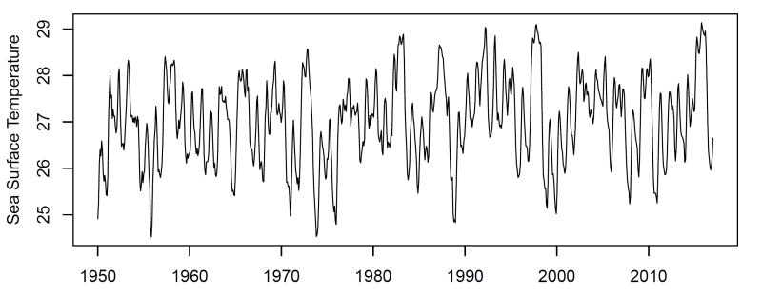
What Generates the Pattern? Key concept: autocorrelation as a function of lag
Places closer to one another are more similar
Correlation falls away as a function of temporal distance, or lag
‘Autoregressive’ pattern

Slide 17
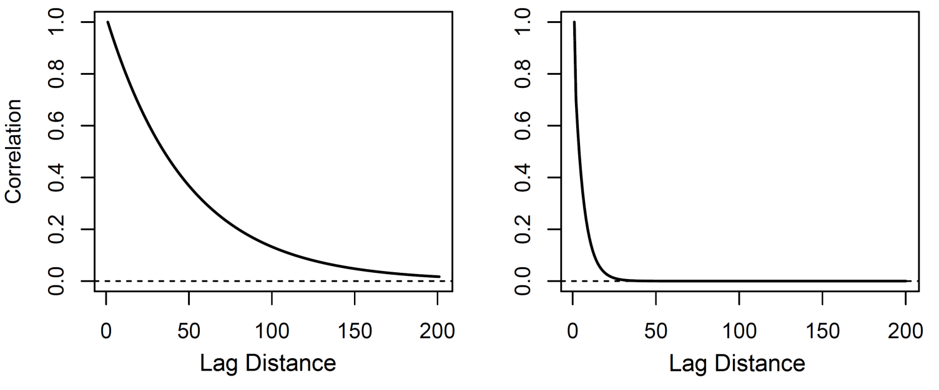
Autocorrelation functions
Decorrelation parameter (aka range, decay, …) quantifies how correlation falls away as a function of lag
Autoregressive model used to characterize this dependency
Space and time dimensions can be treated equivalently

Slide 18
WHY SHOULD ENVIRONMENTAL SCIENTISTS CARE?
Two Primary Reasons:
Dynamics: Learn about the periodicities and characteristic fluctuations of the environmental process Inference: Width of confidence intervals, p.values, posterior probabilities, and other empirical inferences depend critically on the characterization of autocorrelation

Slide 19

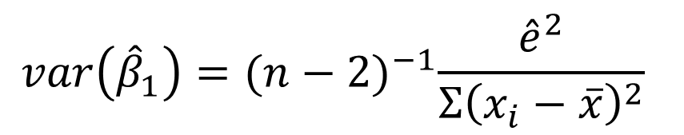
Is there a trend? ..a first attempt
$$var\left({\hat{β}}_{1}\right)={(n−2)}^{−1}\frac{{\hat{e}}^{2}}{{Σ\left(x_{i}−\overline{x}\right)}^{2}}$$
*assumes data are independent check Wikipedia for a derivation
simpler derivation a little later
Indicates strong evidence Alert the press! The ocean is warming!

Slide 20
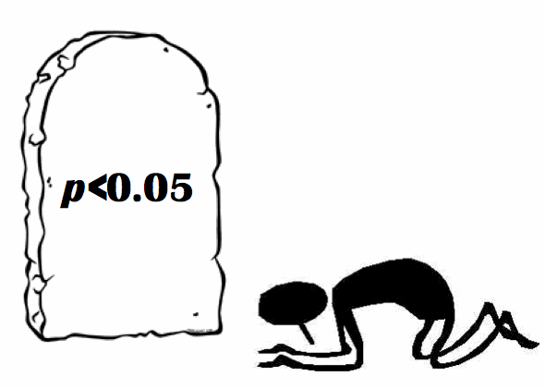
What the %*& is a p.value, anyway? .. and so we dive into a bit of theory

Slide 21
A p.value postulates an ensemble of sample realizations under a hypothetical null model
Suppose the true slope w.r.t. to time is zero (no trend in the system). Under repeated random time series sampling from this system, what is the probability of calculating a trend of equal or greater magnitude than the I observe? -> If the probability is sufficiently low, one rejects the null model
In the context of time series, we consider the common null model of an independent and identically distributed Gaussian variable to see how autocorrelation alters the behavior of what we’d expect with nothing going on, using trend analysis as an example

Slide 22
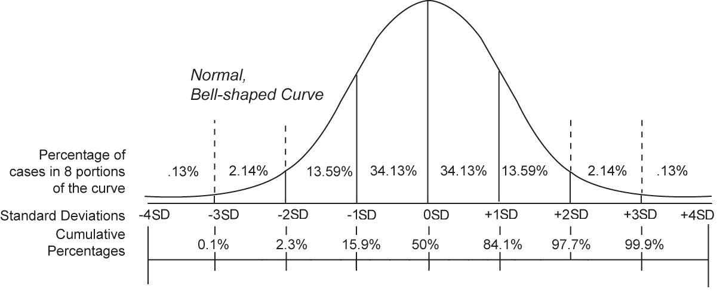
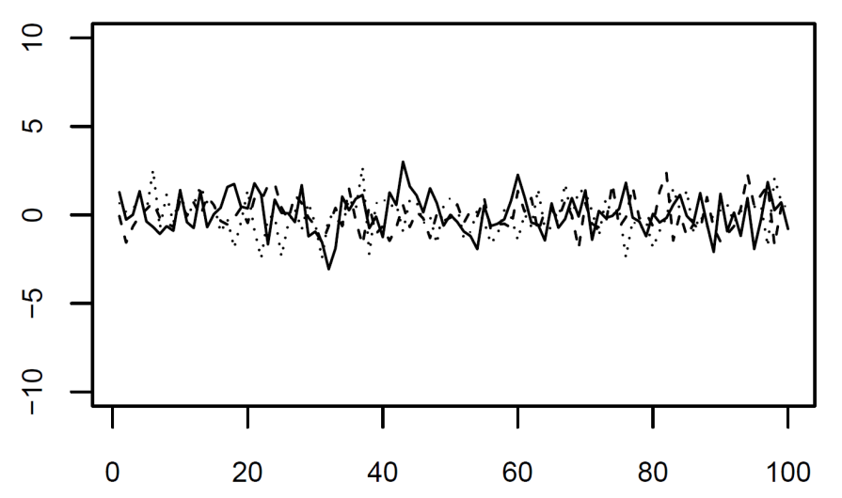
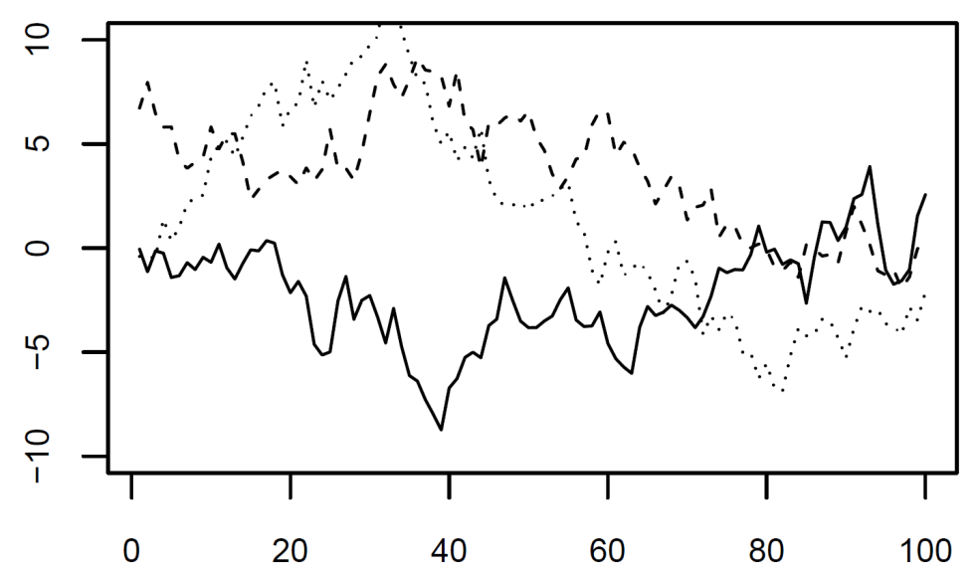
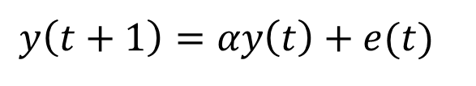
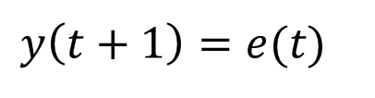
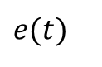
The concept of stochastic realization
$$y\left(t+1\right)=e(t)$$
$$y\left(t+1\right)=αy\left(t\right)+e(t)$$
Common in science to interpret e(t) as an applied force
$$e(t)$$

Slide 23
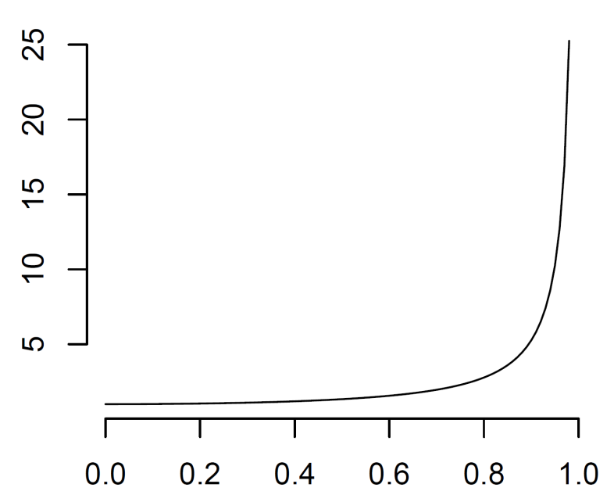
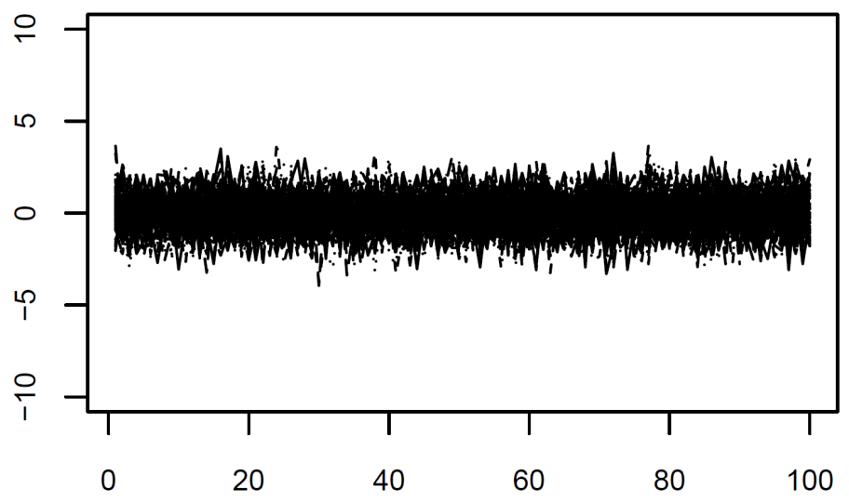
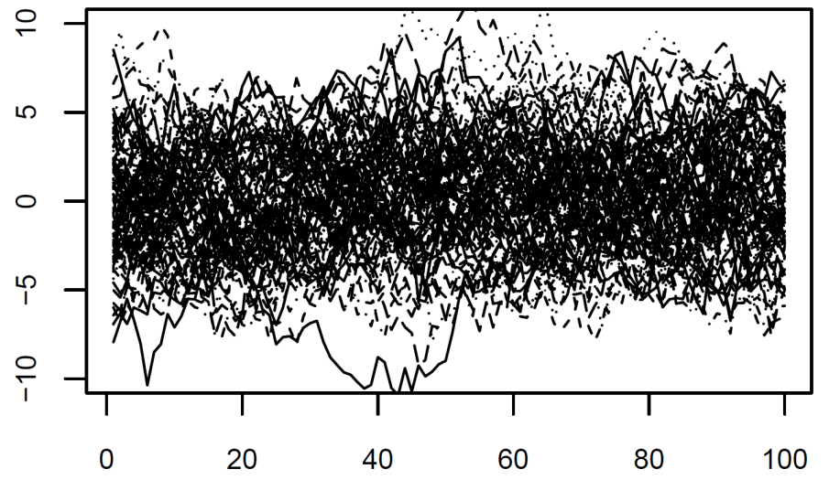
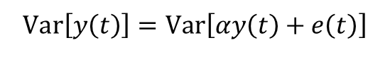
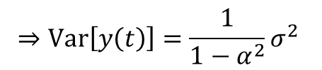
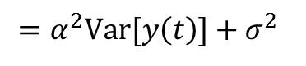
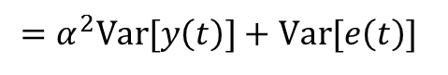
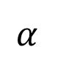
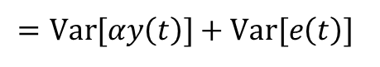
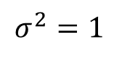
The expected variance of a temporal process, correlated and uncorrelated
$$Var\left[y\left(t\right)\right]=Var\left[αy\left(t\right)+e\left(t\right)\right]$$
$$σ^{2}=1$$
$$=Var[αy\left(t\right)]+Var[e\left(t\right)]$$
$$=α^{2}Var[y\left(t\right)]+Var[e\left(t\right)]$$
$$=α^{2}Var[y\left(t\right)]+σ^{2}$$
$$⇒Var\left[y\left(t\right)\right]=\frac{1}{1−α^{2}}σ^{2}$$
$$α$$

Slide 24
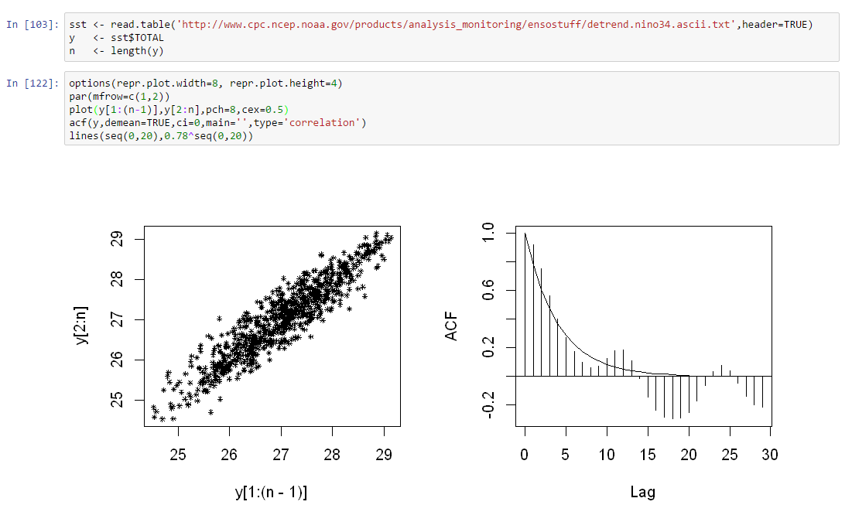
Estimate the autocorrelation function
INSERT PYTHON ALONGSIDE

Slide 25
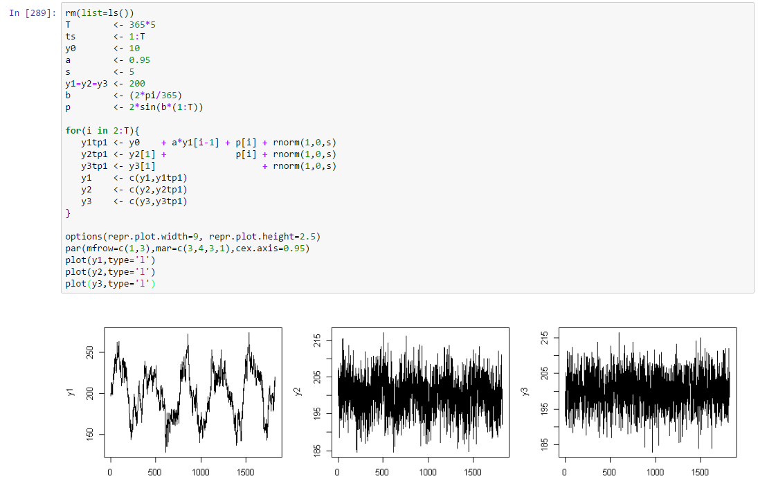
Simulate Different time series with different properties
INSERT PYTHON ALONGSIDE

Slide 26
Exercise
Try simulating data with different properties and estimating their autocorrelation function

Slide 27

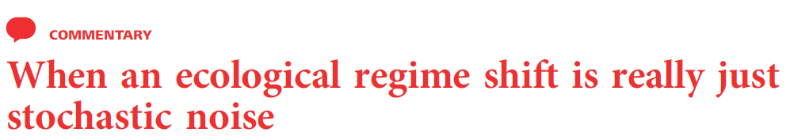
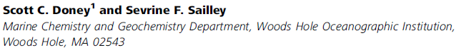
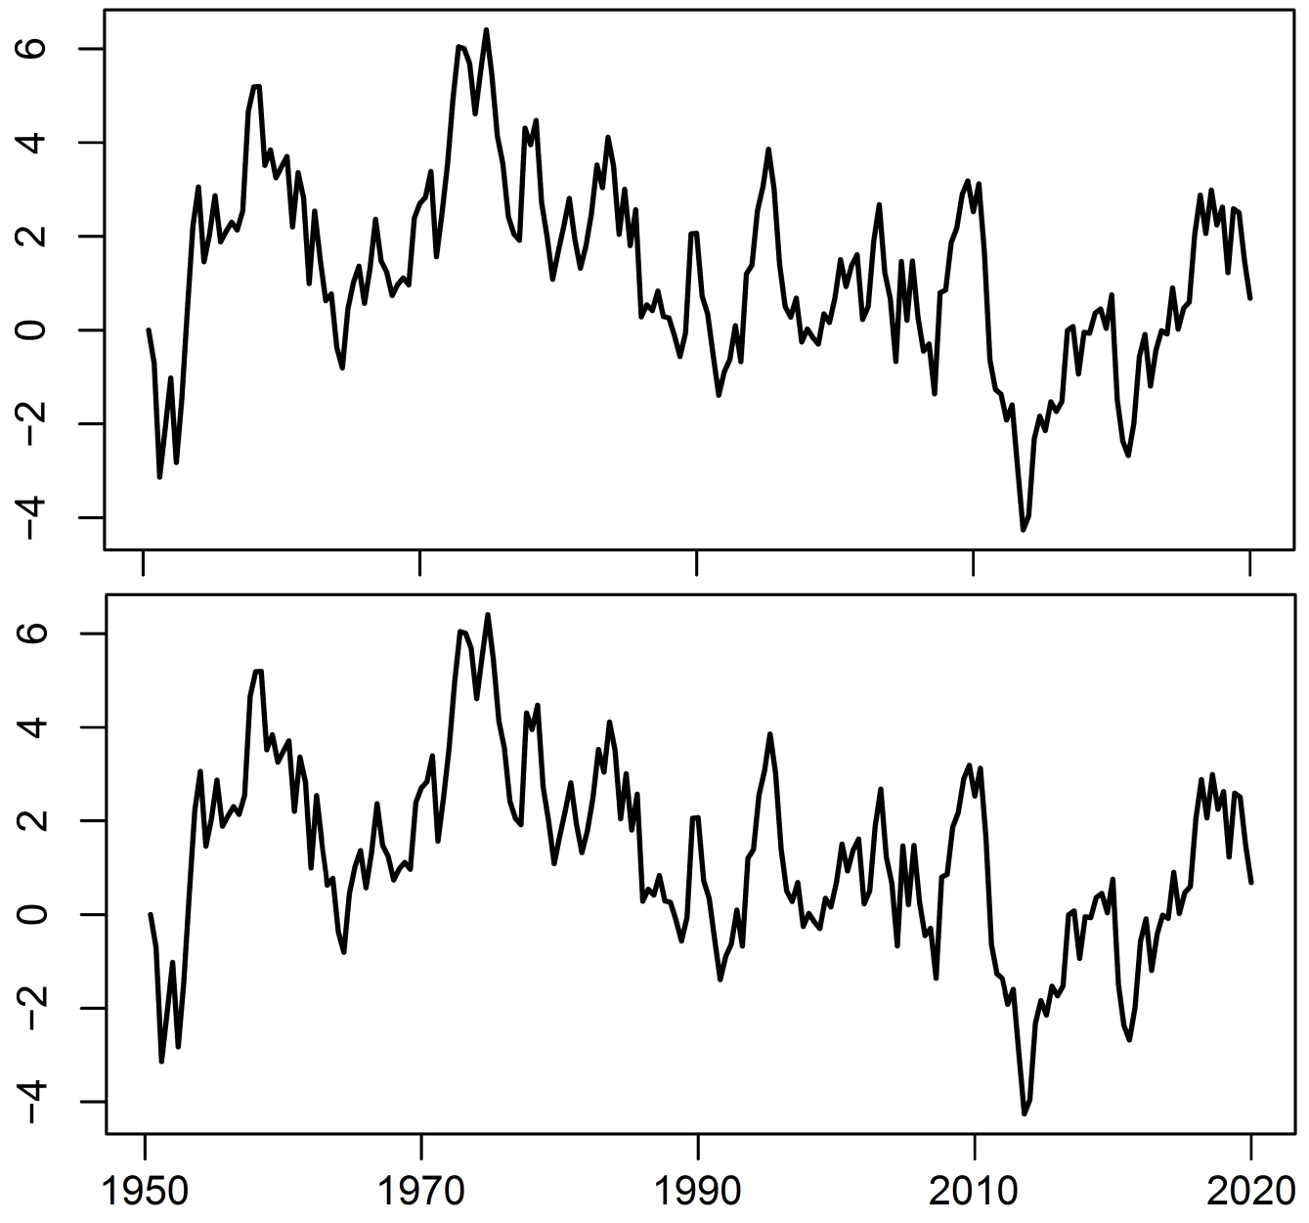
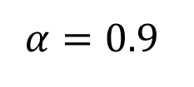
$$α=0.9$$

Slide 28
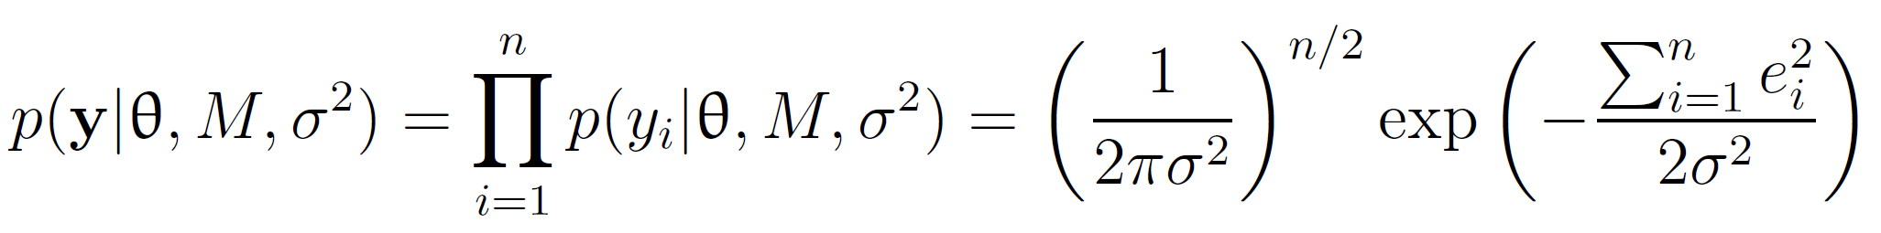
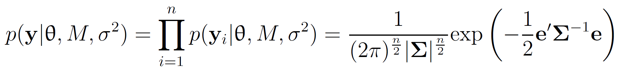
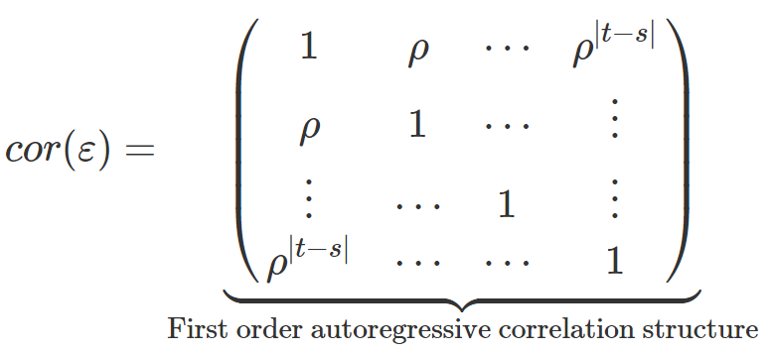

The almighty variance-covariance matrix

Slide 29




How does autocorrelation affect our inference?
Suppose we would like to estimate a simpler quantity, the mean historical SST
*sum over elements of the covariance matrix
Assuming each pair of points Xi, Xk have correlation rho

Slide 30



Fitting a Model with Temporal Autocorrelation
Much weaker evidence!

Slide 31
Summary
Variance of our null model increased with the degree of autocorrelation
A ‘trend-like’ time series is much more likely with autocorrelation, even when nothing interesting is happening; when uncontrolled, the tendency is almost always toward overconfidence
We can control for autocorrelation in most statistical models via specification of a covariance matrix that parameterizes covariance/correlation as a function of lag
We’ll look more deeply into real time series after break

Slide 32
BREAK

Slide 33


Dataset #1: Ozone time series at single station
What’s Going on with our Air?
EPA Air Quality Station Data, Orange County

Slide 34

Time series of ozone data

Slide 35

Variables n ≡ number of sample
ozone mean daily ozone
ozone_max
hour_max
Variables n ≡ number of sample
ozone mean daily ozone
ozone_max
hour_max

Slide 36

Simple Trend Analysis

Slide 37



Harmonic regression
Include a periodic covariate with frequency w cycles/time and phase eta
This variable is nonlinear in the parameters. Use the double-angle formula and rewrite the variable as two terms with constant coefficients:
Now we can model any frequency with an arbitrary phase using two terms in a linear regression, with

Slide 38

Harmonic regression

Slide 39
Exercise
Look for evidence of a seasonal cycle in other variables in the Orange Country ozone data
Try defining shorter and longer frequencies and fit those variables to the ozone data

Slide 40

An aside: Aliasing
The highest resolvable frequency is that at which observations are resolved. Sampling design can maximize information at particular frequencies

Slide 41


An Aside: The Power Spectrum
Statistically interpreted as the proportion of variance accounted for by each frequency ‘Fourier analysis’ is a rich area of highly relevant area applied mathematics not dealt with here…

Slide 42

Time Series Decomposition

Slide 43
Exercise
Decompose other variables into their harmonic, trend, and noise components
Do any variables have a significant trend after correcting for seasonality and autocorrelation?

Slide 44

Time series regression

Slide 45

Time series regression

Slide 46


Simple Model Selection
The ‘best’ model is the one that minimizes the criterion
R and Python readily provide these quantities
More interpretable than p.values, but still no replacement for good judgment

Slide 47

Simple Model Selection
R2 always increases with the number of parameters
BIC penalizes more parameters and can be used to select the ‘best’ model

Slide 48
Exercise
Try to find the single best predictor of mean daily ozone concentration, after correcting for seasonality and autocorrelation
Fit multiple regressions and try to find the best model in terms of BIC

Slide 49
LUNCH

Slide 50


What Generates the Pattern? Direct generalization of time: correlation as a function of lag
In space, this pervasive phenomena generates pattern
This simple fact has broad implications that can play tricks on our ideas about science!

Slide 51
Autocorrelation functions

Slide 52

Simulate spatially autocorrelated data

Slide 53

Simulate spatially autocorrelated data

Slide 54
Exercise
Try generating spatial patterns with different decorrelation parameters and look at the resulting patterns

Slide 55

Temperature and Precipitation
Climatology of Oregon

Slide 56

Spatial Interpolation
We often want to ‘fill in’ values where data are not observed
Many techniques of varying complexity
‘Kriging’ is a type of regression model

Slide 57

Spatial interpolation
Often want to ‘fill in the map’

Slide 58

Spatial Interpolation
Numerical packages usually work with the variogram, that includes an additional asymptotic parameter

Slide 59

Spatial Interpolation

Slide 60

Spatial Interpolation

Slide 61
Exercise
Interpolate several variables
Define a new variable, representing the difference in temperature between July and January, and interpolate that variable

Slide 62

Spatial Regression

Slide 63

Spatial Regression

Slide 64

Spatial Regression

Slide 65


Model Selection

Slide 66
Spatial Regression Exercise
Find the best fitting single and multivariable model
Produce a kriged prediction field

Slide 67

Derived spatial variables
Construct a new variable

Slide 68
Exercise
Construct new spatial variables that may capture the effect of the rain shadow and test the relationship with the data while controlling for spatial autocorrelation

Slide 69
Wrapping Up
Learned basic concepts, datasets relatively small
Directly generlizes to higher dimensions, but becomes computationally infeasible with built-in optimizers
Two-day workshop next year using Stan
Hackathon

